Slide 1
Hello, PyCon.
Hilary Mason
@hmason h@bit.ly

Slide 2
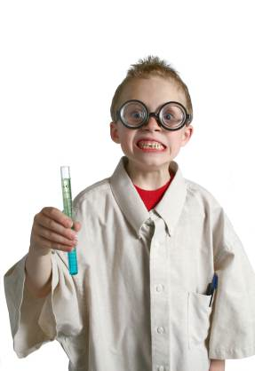
Notes:
I’m a scientist.

Slide 3
http://docs.python.org/library/multiprocessing.html
http://bit.ly/gAoGqE
Notes:
We make big URLs short!

Slide 4
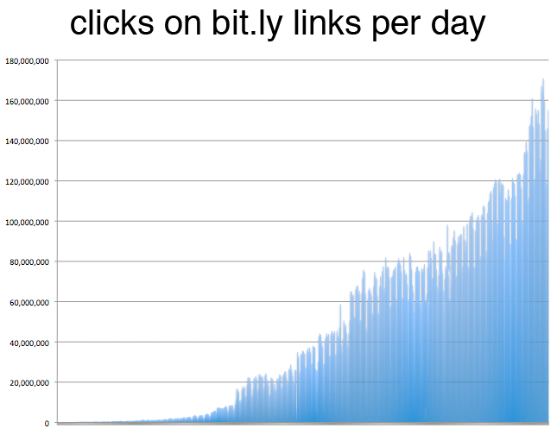
wicked hard problem
10s of millions of URLs /day
100s of millions of events / day
1000s of millions of data points

Slide 5
a= 'print "a=",repr(a);print "exec(a)"'
exec(a)
Notes:
The name "quine" was coined by Douglas Hofstadter in his popular science book Gödel, Escher, Bach: An Eternal Golden Braid in the honor of philosopher Willard Van Orman Quine (1908–2000), who made an extensive study of indirect self-reference, and in particular for the following paradox-producing expression, known as Quine's paradox:
"Yields falsehood when preceded by its quotation" yields falsehood when preceded by its quotation.

Slide 6
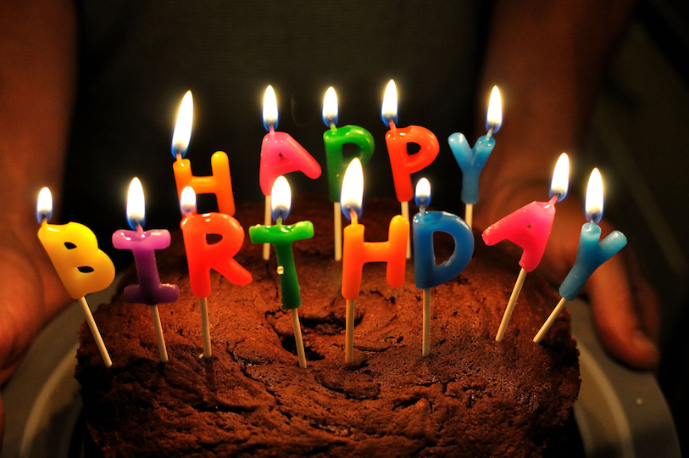
Notes:
http://www.flickr.com/photos/spool32/5045502202/

Slide 7
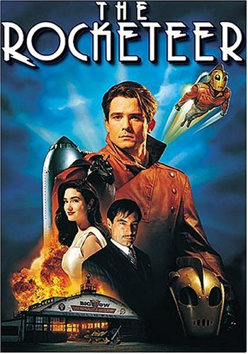
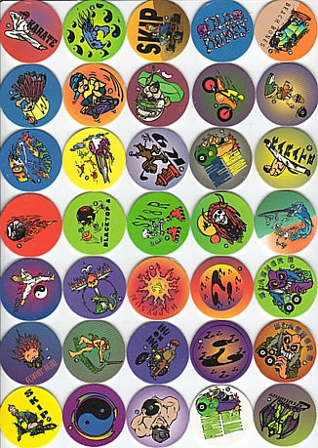
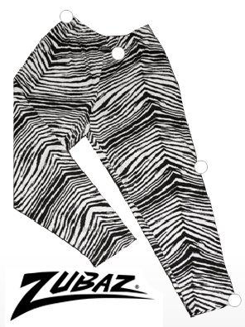
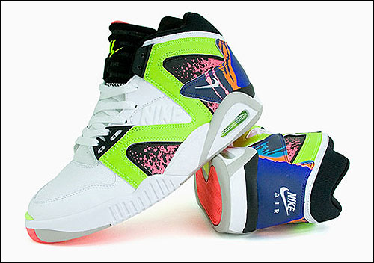
Notes:
We’ve come a long way since the 1990s…

Slide 8
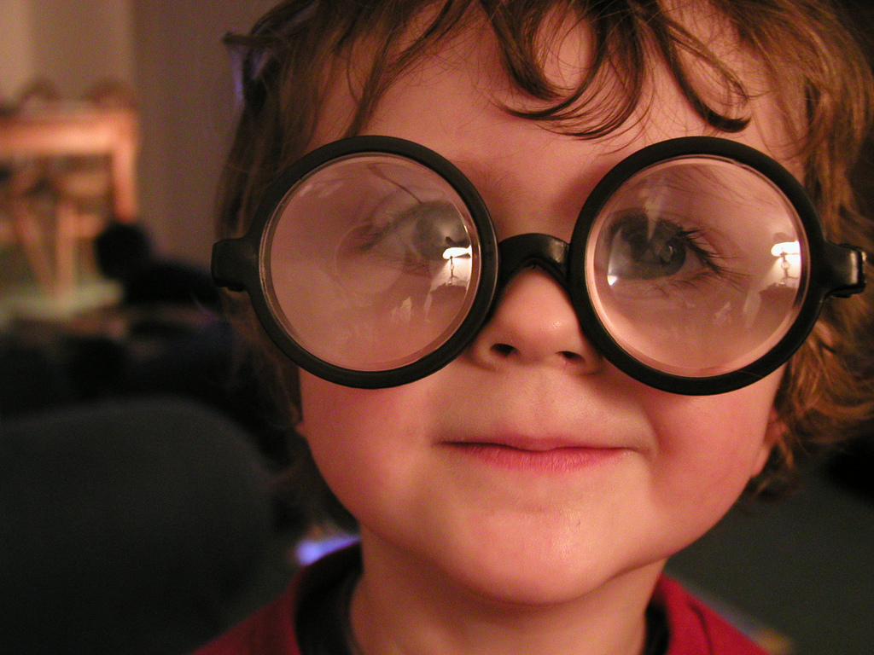
[a lot to celebrate]
Notes:
http://www.flickr.com/photos/wapster/4037626326/
A lot to celebrate!
In this talk, I want to talk about where we are, both in terms of Python as a language and a community
I want to talk about madness
I’m going to talk what’s next
A bit of super fun stuff at the end

Slide 9
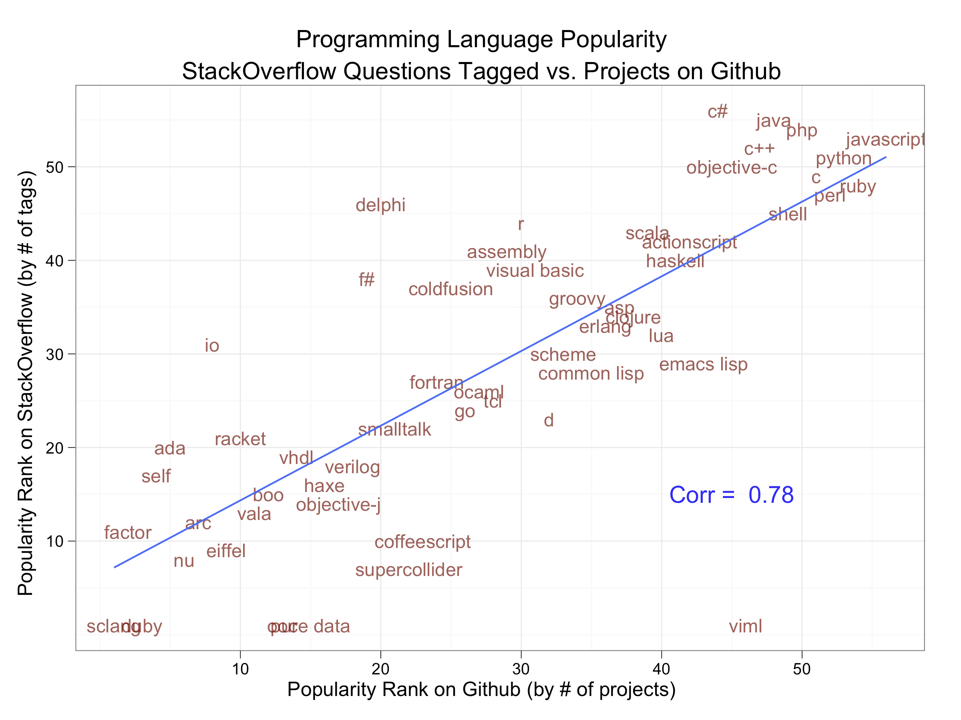
http://www.dataists.com
http://bit.ly/i9W6K5
Notes:
Drew Conway and John Myles White
http://www.dataists.com/2010/12/ranking-the-popularity-of-programming-langauges/

Slide 10
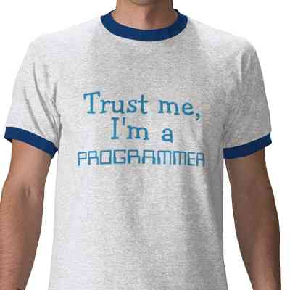
http://bit.ly/eDrFCJ
Notes:
We love it, we’re doing something right!

Slide 11
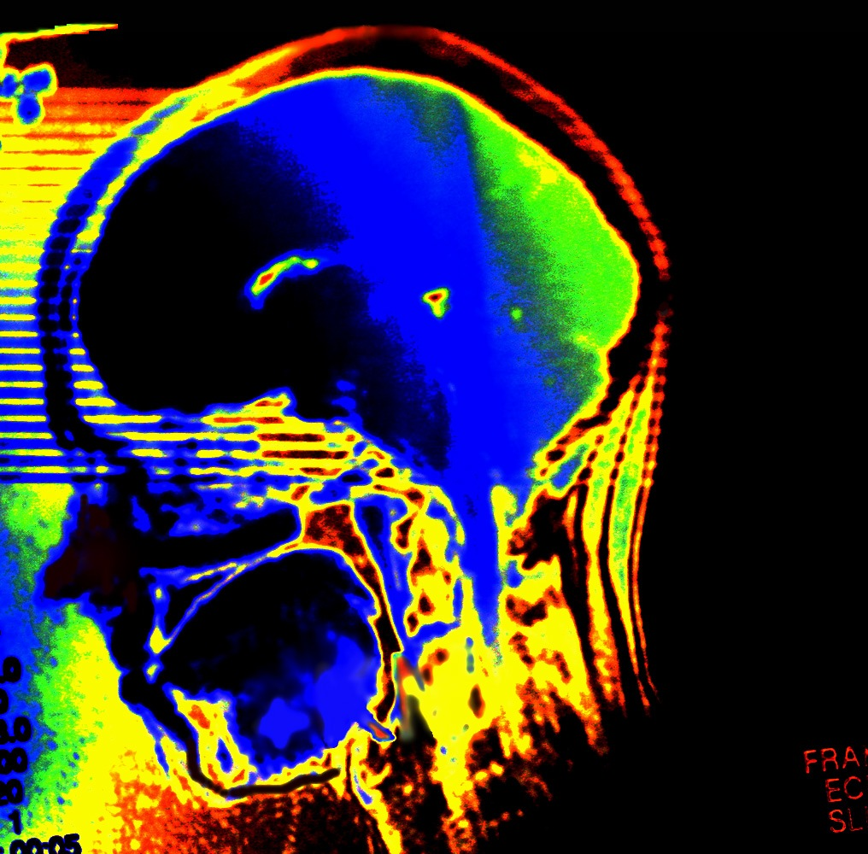
Notes:
http://www.flickr.com/photos/29487767@N02/2845044715/
What’s happening to our brains when we write code?

Slide 12
Computational thinking means creating and making use of different levels of abstraction, to understand and solve problems more effectively.
http://www.cs.cmu.edu/~CompThink/
Notes:
New educational philosophy
Education requires not just facts and methodology but also enthusiasm

Slide 13
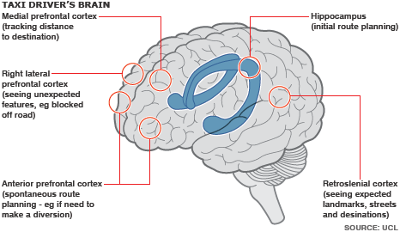
BBC: Taxi drivers ‘have brain sat-nav’
http://bbc.in/f20qmq

Slide 14
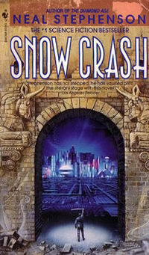

Slide 15
“If you’ve never programmed a computer, you should. There’s nothing like it in the whole world.”
– Cory Doctorow, Little Brother

Slide 16
[joy]
Notes:
There are some things that just make us ridiculously happy. Puppies, kittens, chocolate, coffee, and code.
http://dogs.icanhascheezburger.com/2009/03/19/cute-puppy-pictures-hand-held/

Slide 17
Which Python constructs make you happy?

Slide 18
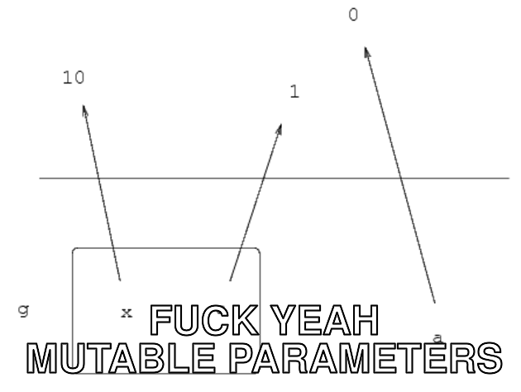
http://fuckyeahnouns.com/mutable%20parameters

Slide 19
with
with open("jenkins.c") as f:
data = f.read()
print data

Slide 20
generators
total = sum(num * num
for num in xrange(1, 1000000000))

Slide 21
decorators
@imadecorator
def imafunction():
print 'inside'

Slide 22
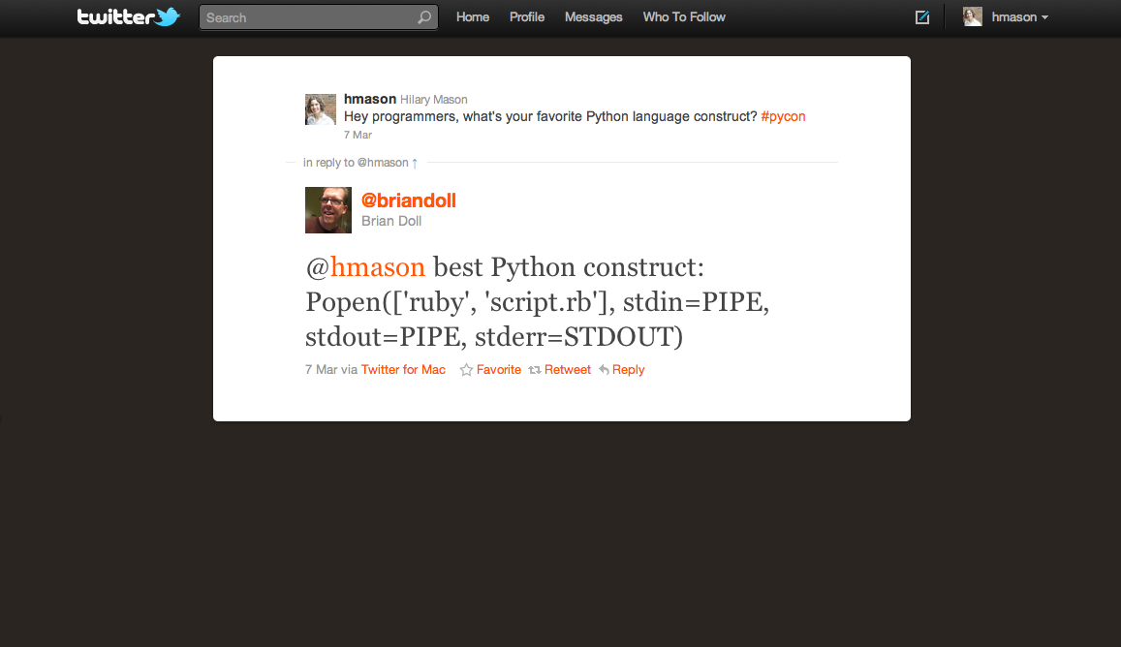

Slide 23
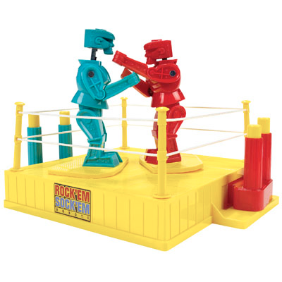
(ridiculous, yes)

Slide 24
And the winner is…?

Slide 25
List Comprehensions
squares = [n ** 2 for n in range(10)]

Slide 26
<3
Notes:
Why does everyone love it so much? Where does it come from?

Slide 27
Notes:
Set builder notation

Slide 28
SETL
[n in [2..N] | forall m in {2..n - 1} | n mod m > 0]
Notes:
1969
Jack Schwartz at NYU

Slide 29
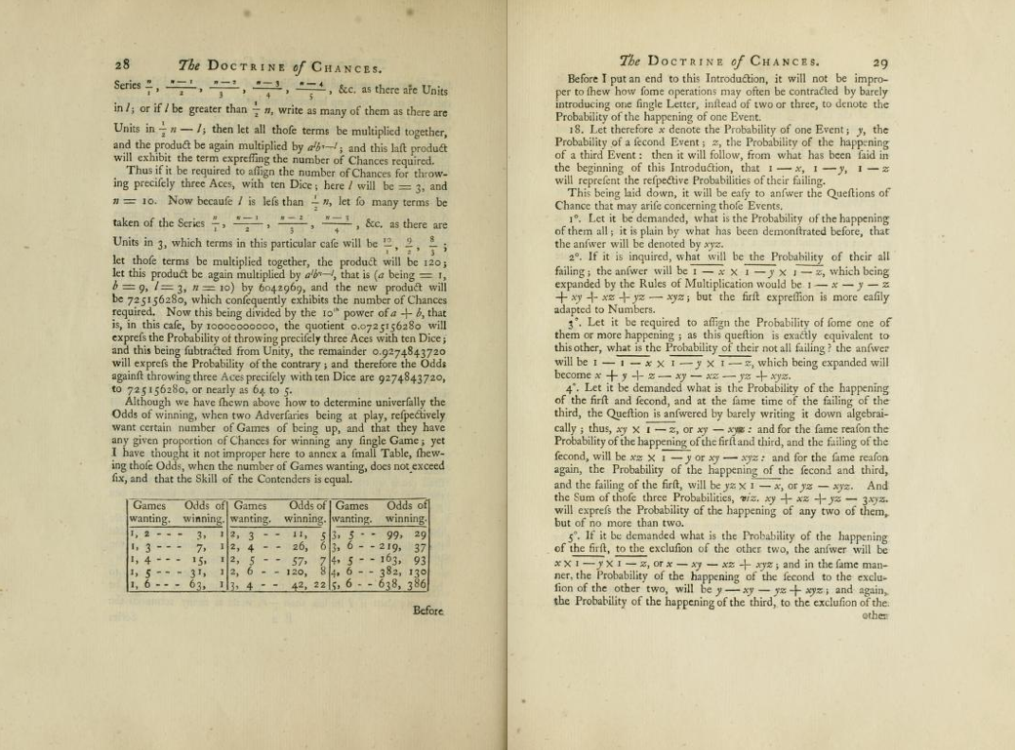
[older math]
Notes:
The Doctrine of Chances, 1756 by A DE Moivre
http://openlibrary.org/books/OL6239276M/The_doctrine_of_chances
The doctrine of chances
or, A method of calculating the probabilities of events in play.
3d ed., fuller, clearer, and more correct than the former.
Published 1756 by printed for A. Millar in London .
Written in English.

Slide 30
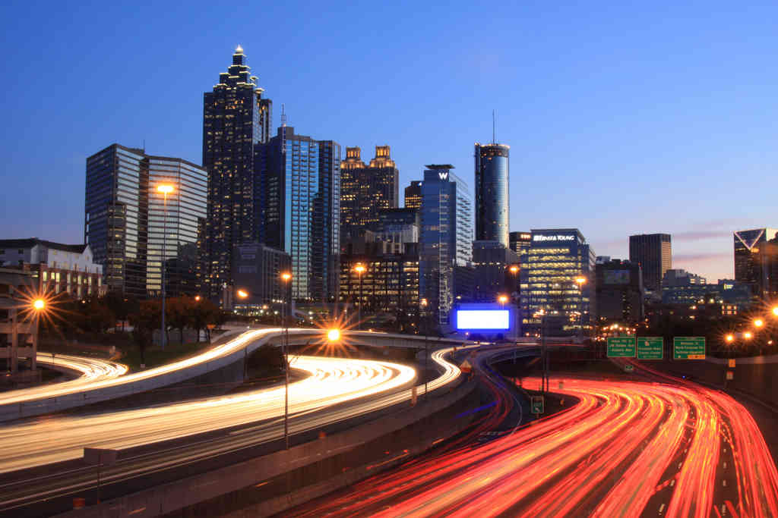
[today.]
Notes:
Here we are today, in Atlanta, and we’ve come a long way, but we haven’t actually come that far at all.
http://www.flickr.com/photos/ajbrustein/4101414657/

Slide 31
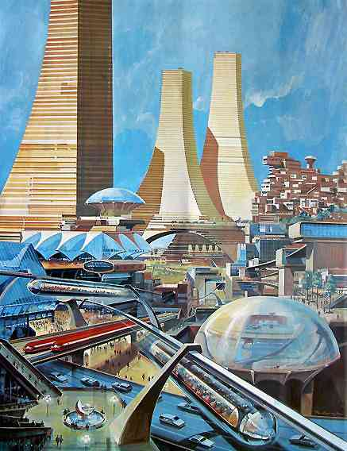
Notes:
http://ilaue.wordpress.com/2010/07/25/the-death-of-the-retro-future/

Slide 32
What’s next?

Slide 33
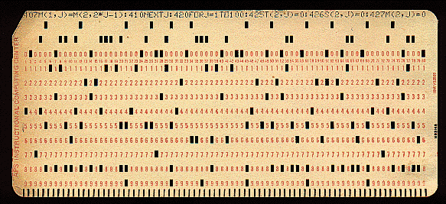
Data.

Slide 34
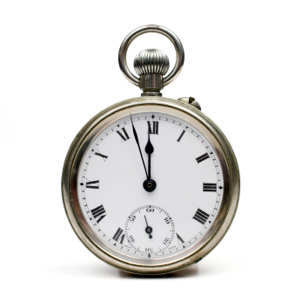
Realtime.

Slide 35
Massively. Parallel. Computing.
Notes:
Ubiquitous, asynchronous

Slide 36
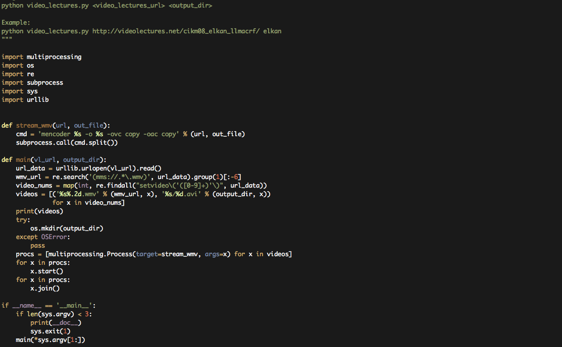
WTF?
http://bit.ly/ezd9UE
Notes:
https://github.com/bwhite – Brandon White

Slide 37
Notes:
Infrastructure – Redefining what it means to be “close to the metal”.
http://www.flickr.com/photos/kky/704056791/

Slide 38
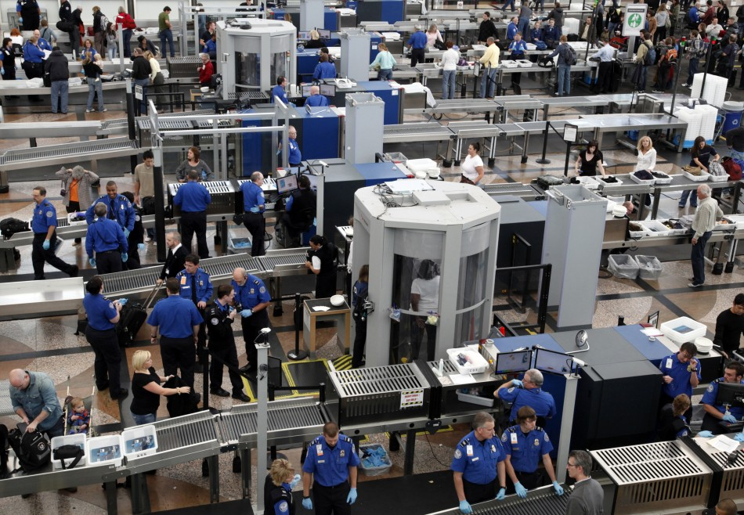
[memory and security]
Notes:
SECURITY
Android, every program is a unique user…
http://img.ibtimes.com/www/data/images/full/2011/02/02/62802-tsa-workers-carry-out-security-checks-at-denver-international-airport-.jpg

Slide 39
Process and security.

Slide 40
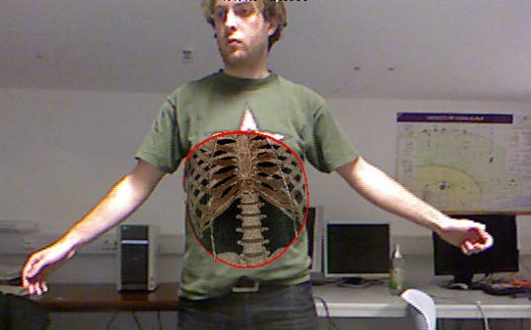
http://engt.co/e9QPj2

Slide 41
Interactions.

Slide 42
“How can we build computer systems that automatically improve with experience, and what are the fundamental laws that govern all learning processes?”
-- Tom Mitchell, CMU
Notes:
Each field is defined by one question. This one is ours.

Slide 43
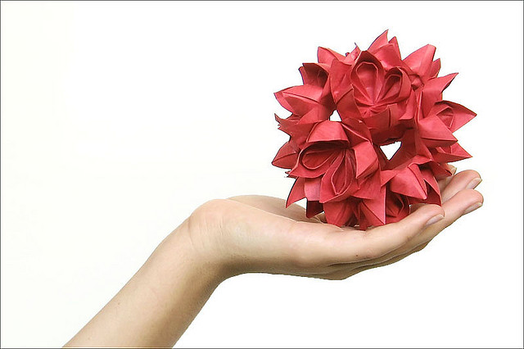
Notes:
It is the responsibility of the language to provide a grammar for addressing abstract problems that emerge from data that we can’t yet really imagine.
http://www.flickr.com/photos/etringita/2722410302/

Slide 44
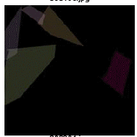
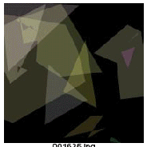
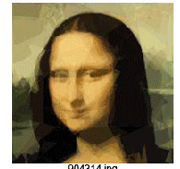
Evolving the Mona Lisa.
http://bit.ly/i5LC1w
Notes:
Roger Alsing, 2008

Slide 45
Sense.
Notes:
We need to construct systems that find sense in data and create their own abstractions.

Slide 46
Notes:
Let’s create that world where we all have SUPERPOWERS!
http://www.flickr.com/photos/eyecaramba/9936251/sizes/o/in/photostream/

Slide 47
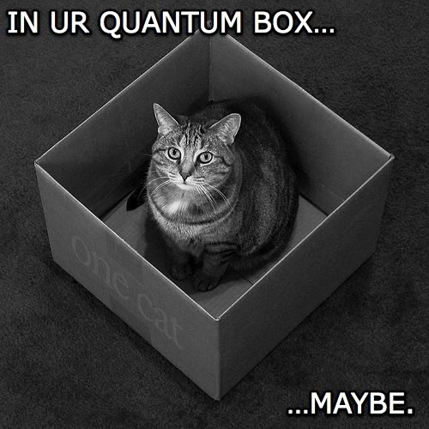
Notes:
Fun stuff, now

Slide 48
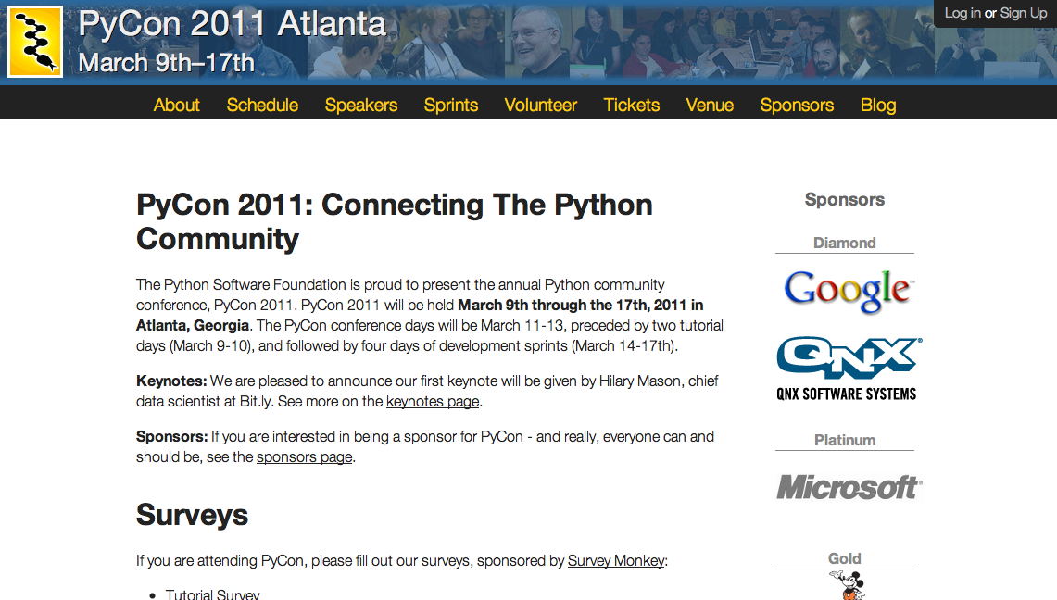

Slide 49
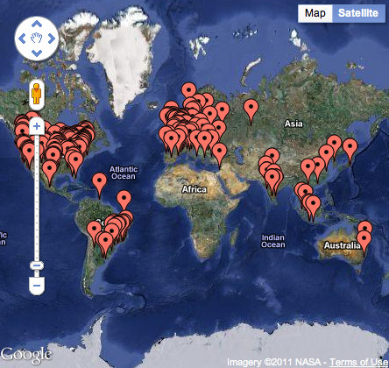
Notes:
People who click on .*pycon.org.* come from….

Slide 50
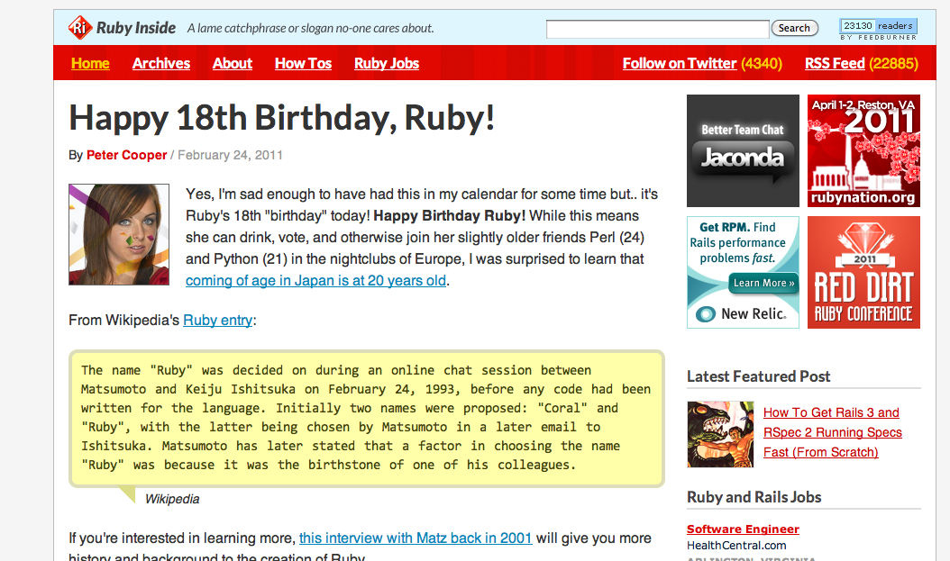
Notes:
People who click on .*pycon.org.* also click on this….

Slide 51
Notes:
And this

Slide 52
Notes:
And this!!

Slide 53
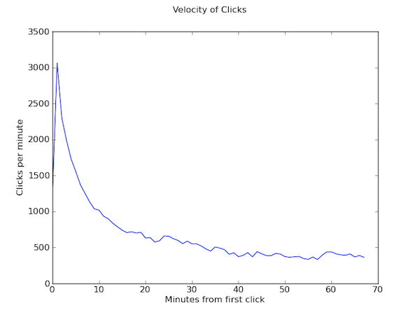
Notes:
Look at rate of change over time and calculate the slopes of these curves.

Slide 54
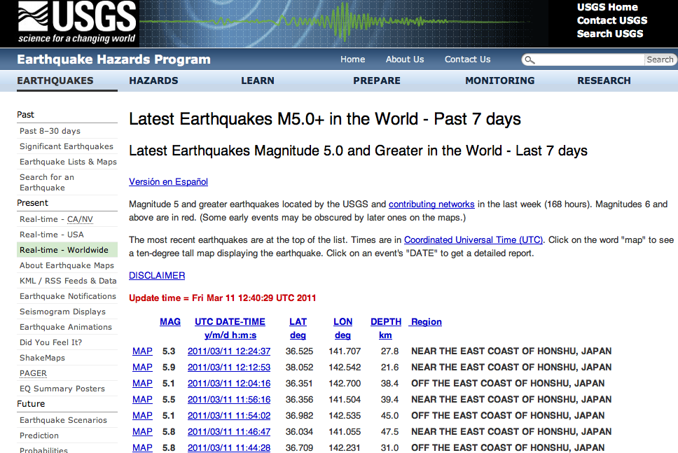

Slide 55
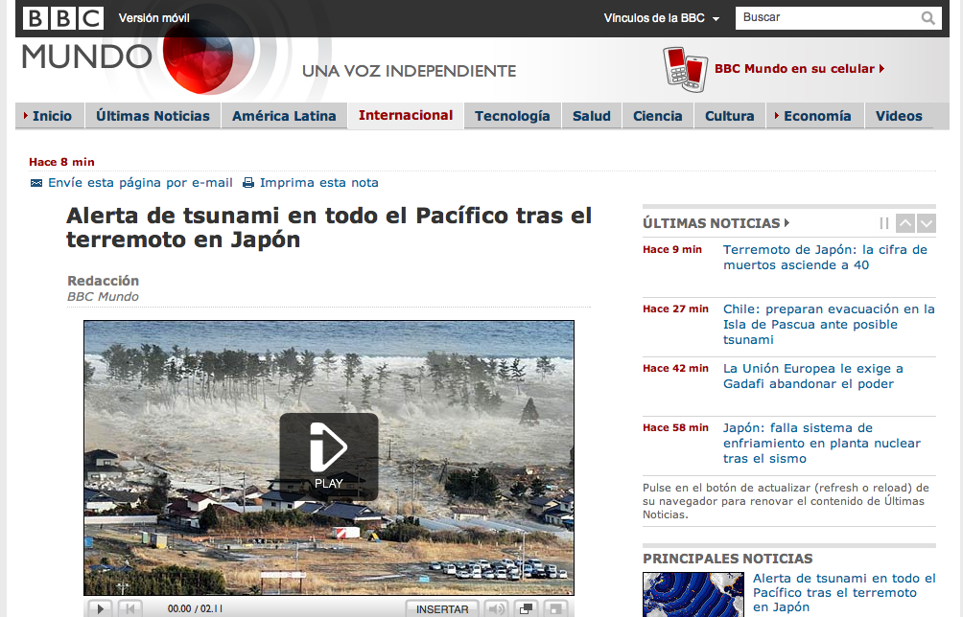

Slide 56
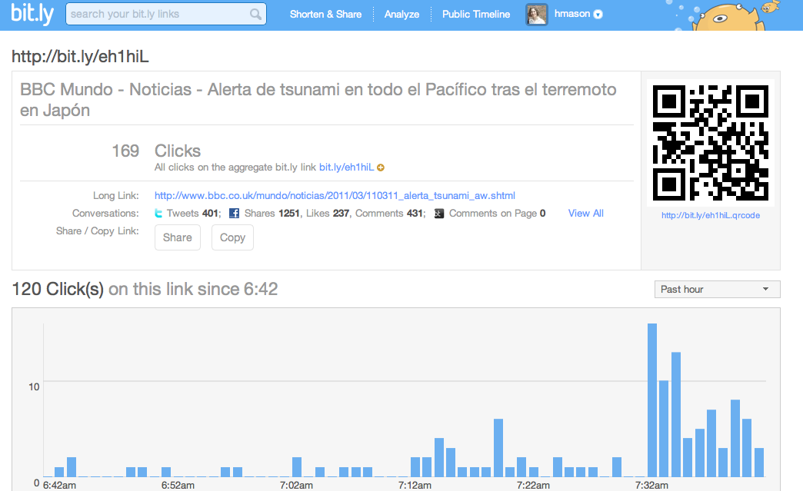

Slide 57
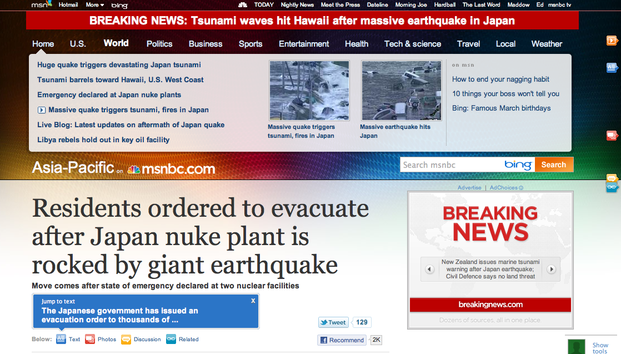

Slide 58
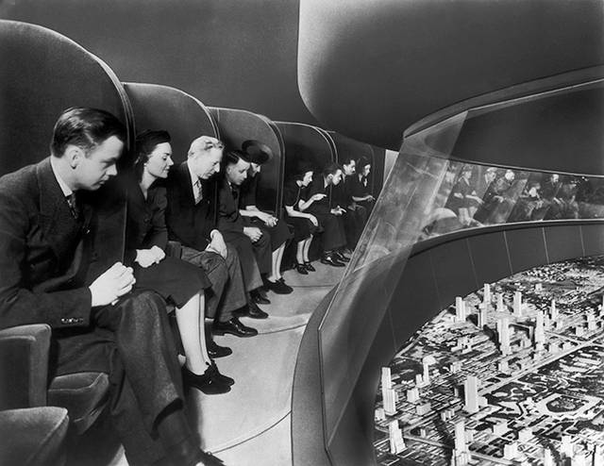
Notes:
Futurama, 1939 world’s fair

Slide 59
Thank you!
h@bit.ly
@hmason
http://github.com/hmason
http://www.hilarymason.com

