Slide 1
TheConsortium
Demonware data centre management and configuration tool
woosley.xu@demonware.net

Slide 2
About DemonWare
Full subsidiary of Activision Blizzard
Creates and provides the online services behind some of the world’s most popular video game franchises.

Slide 5
In China, we do … …

Slide 7
Demonware Tech

Slide 8
The unpleasant background
Working with traditional datacenter
Dealing with a lot of different backends
Everybody has their own way to do automation
Nobody knows what are the correct choices

Slide 9
so we want to pave a vm
Input hosts information manually into CMDB
use virt-manage to create virtual machines
use cobbler and input the system information
Then use virt-manager to boot it up

Slide 10
Those(and more) were killing everyone in liveops team
Everybody has their own script to automate
Provision should be simple as one command

Slide 11
The Goal of Consortium
Provide a easy to use central API for liveops operations

Slide 14
Core concept
Everything is a kind of node

Slide 15
Core concept
Every node has a set of attributes

Slide 16
For example
A server in IDC is a kind of host, a ip in loadbalancer is a kind of vip
A kind of host can have a lot attributes, like name, interfaces, datacentre, hwspec, puppet_role.
Those attributes are distributed from different systems, like provision system, configuration system, inventory system.
Every node has a unique name to identify itself.

Slide 17
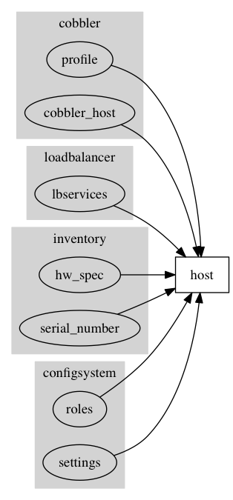

Slide 18
Core concept
Modify attributes can trigger a set of operations

Slide 19
API design
Access node object through its name
GET /api/inventory/host/${name}
PATCH /api/inventory/host/{$name}
Etc …
Pre compiled schema based API which can be easily used for client

Slide 20
{"/api/inventory/datacentre/?$": {
"post": {
"inputs": { "query": { "optional": false, "type": "string" } },
"doc": "Show datacentres matching the given search query.",
"outputs": {
"result": { "type": [ { "name": { "type": "string" },
"full_name": { "type": "string" }, "cached_at": { "type": "int" } } ] } } },
"get": {
"inputs": {},
"doc": "Show information about all datacentres.\n\n",
"outputs": { "result": { "type": [ { "name": { "type": "string" },
"full_name": { "type": "string" },
"cached_at": { "type": "int" } } ] } } } },

Slide 21
Consortium V1
Tornado + Redis
Redis is used to cache node information from all backends by a cronjob for fast query
Tornado is used to nonblockingly talk with different backends

Slide 22
Consort
Everyone’s beloved shell to talk with Consortium

Slide 23
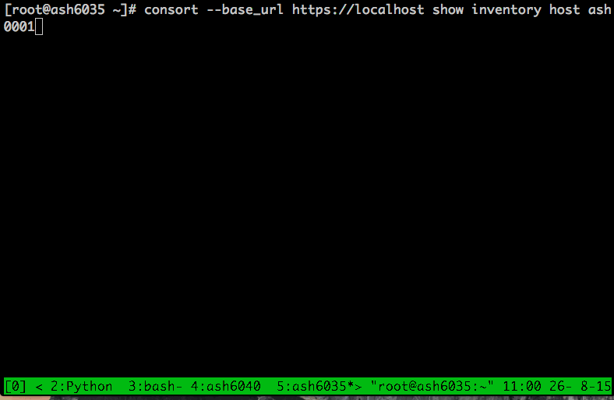

Slide 24
Problems
Predefined workflow
Talking to different backends synchronous, no way to track jobs
Code for different backends are integrated into the base repo directly
Plugin is too hard to write, you have to know how to write nonblocking code using tornado
Notes:
Think about submit the same job twice?

Slide 25
Consortium V2
Separated consortium Core and plugin system
Consortium core as a finite state machine, propose changes to different plugins
Replace Redis with etcd and arangodb
Modifications are now async.

Slide 26
The new plugin system
Each plugin can provide different NodeProviders, like CobblerHostNodeProvider
NodeProvider is essentially provide attributes for a node kind
Different NodeProvider can claim attributes of the same node kind
NodeProvider also claim the authority to some node attributes.
Consortium core is responsible merging those nodes
Notes:
Only one nodeprovide can be authority of a node kind

Slide 27
The great new transitionplanner

Slide 28
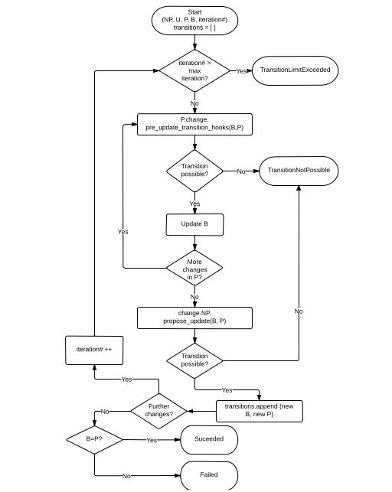

Slide 29
It is not that scary
User sends a set of ProposedUpdates
NodeProvider define a function accept all updates, do some operations and return what ProposedUpdates are accepted.
NodeProvider can also tell transitionPlanner to propose some new updates, which will be merged to ProposedUpdates

Slide 30
TransitionPlanner merge the accepted ProposedUpdates to current node, compare with desired state.
If not satisfied, continue the loop until 1)succeeded 2)failed by exceptions 3)ttl expired.

Slide 31
Show me the code!!

Slide 32
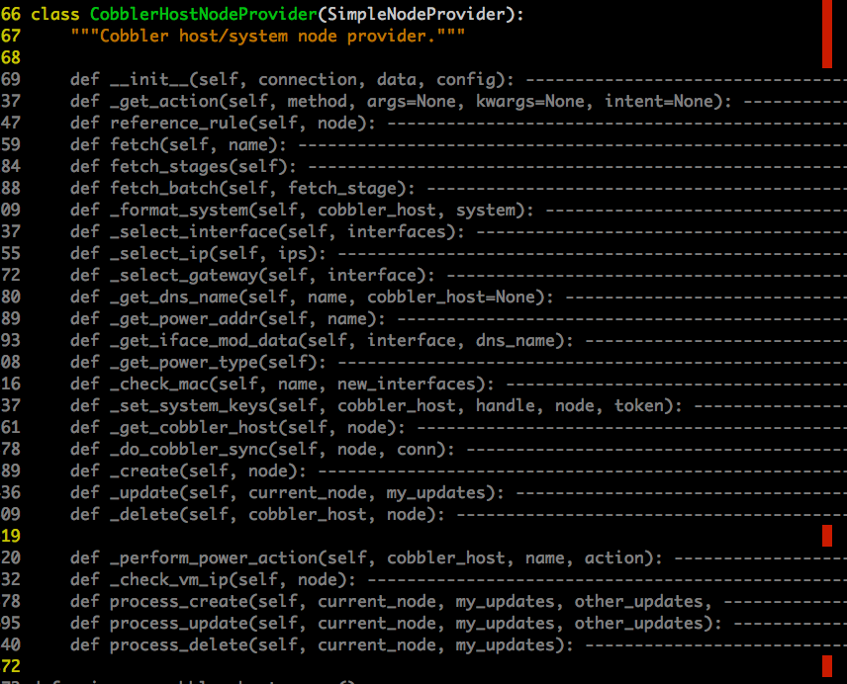

Slide 33
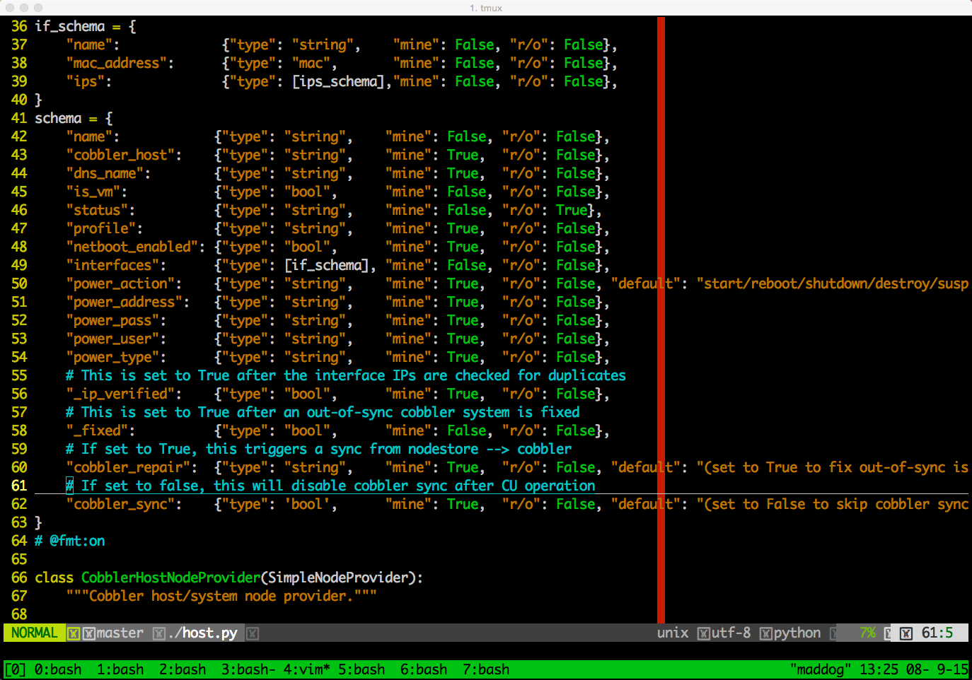

Slide 34
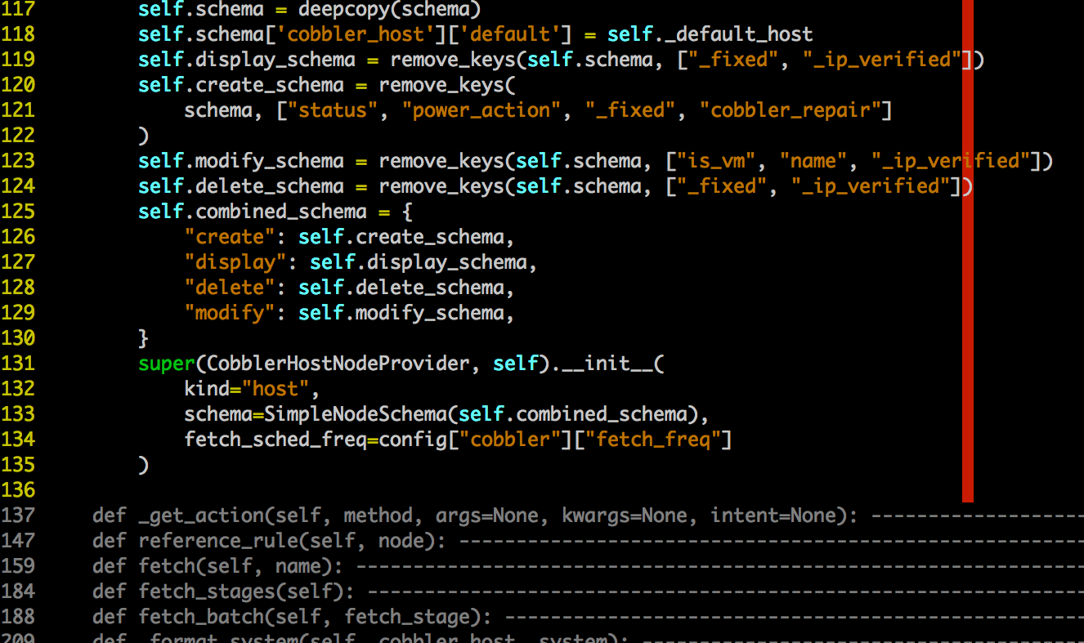

Slide 36
This is great, now show me a working example

Slide 37
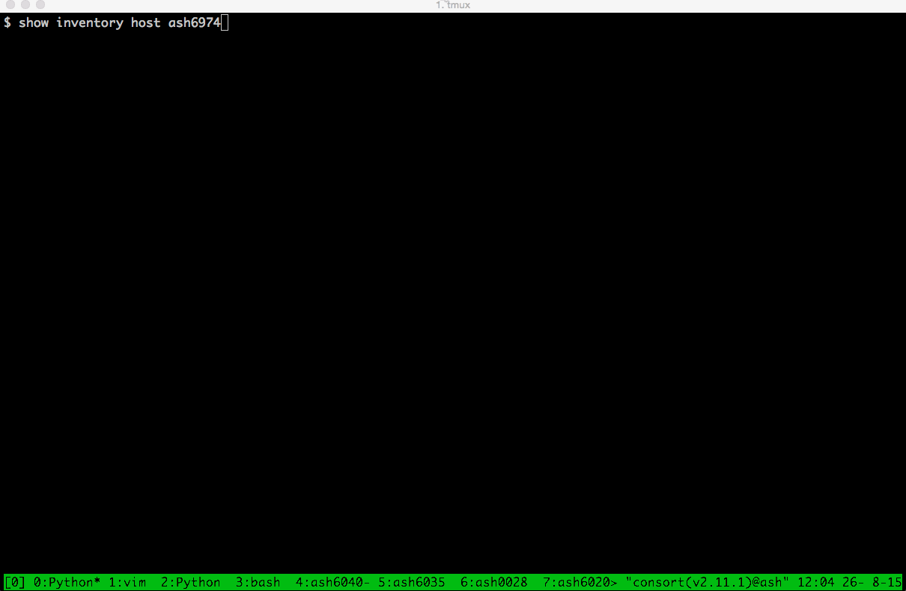

Slide 38
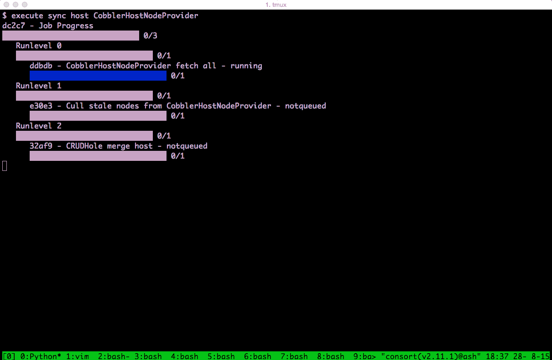

Slide 39
Workers in Consortium
Supervisor worker
Master worker
Web worker: main http interface
Queue worker: workers who run tasks
Notes:
Webworker: main http interface

Slide 40
Etcd and Arangodb
Etcd: LockManager, Queue
Arangodb： A great graph store just works, for jobs and inventory cache

Slide 41
Other cool things

Slide 42
The Search Engine

Slide 43
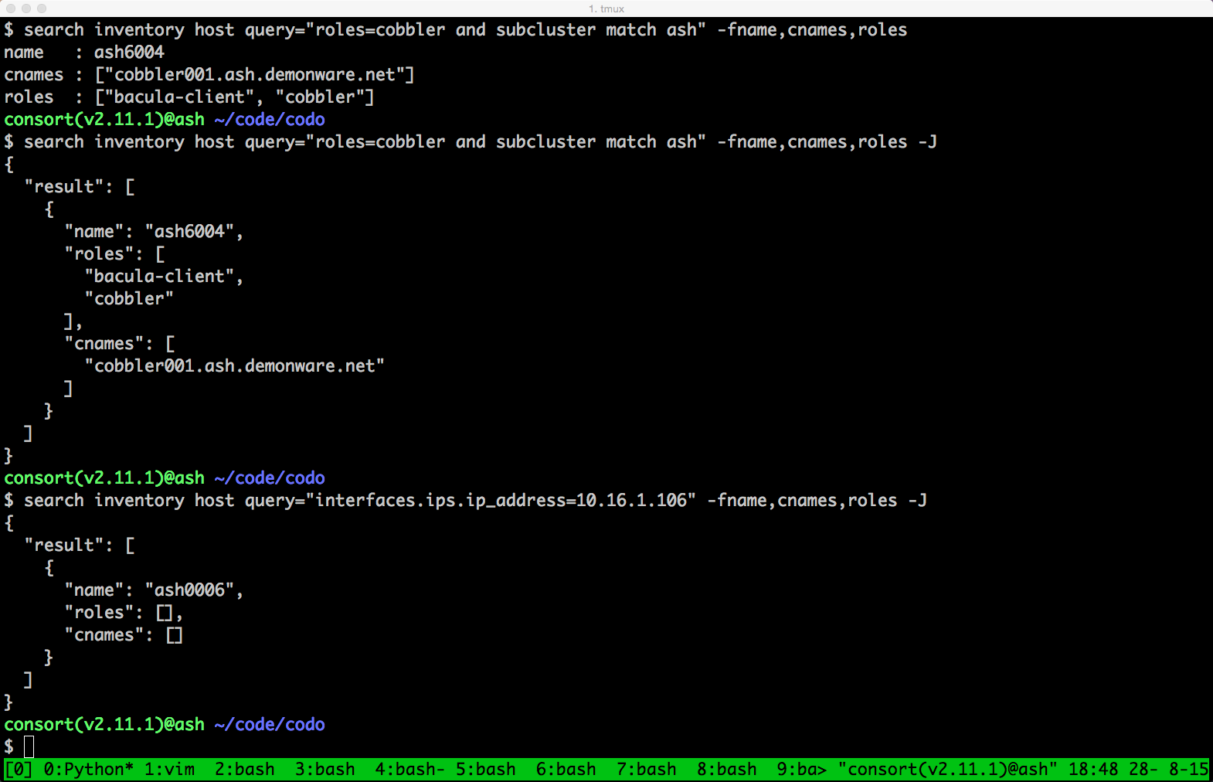

Slide 44
How consortium handle list attributes

Slide 45
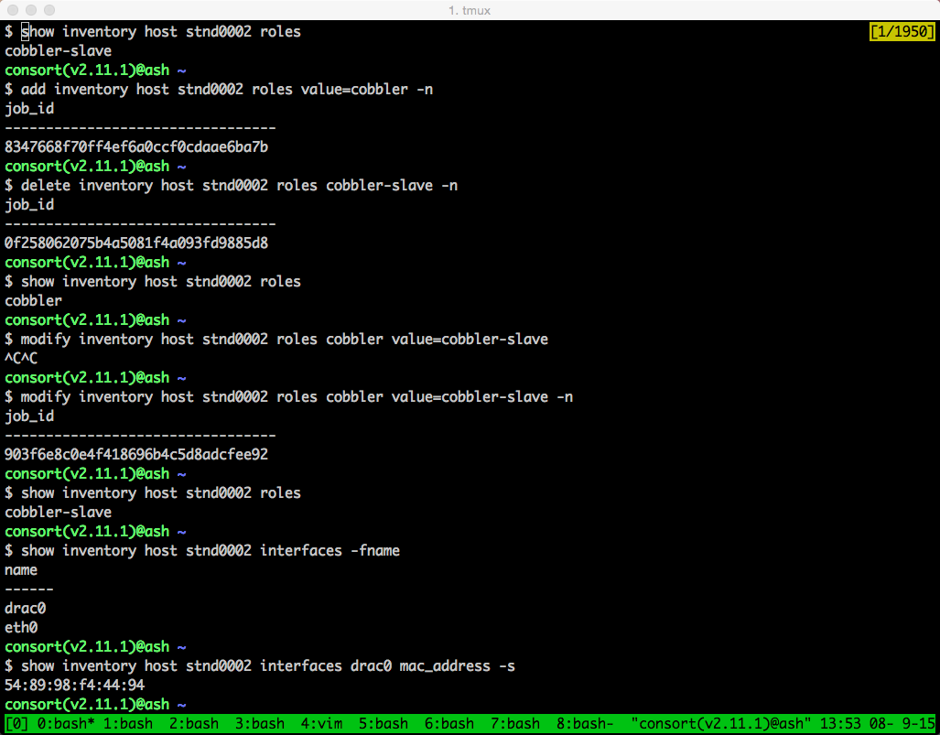

Slide 46
Explain mode

Slide 47
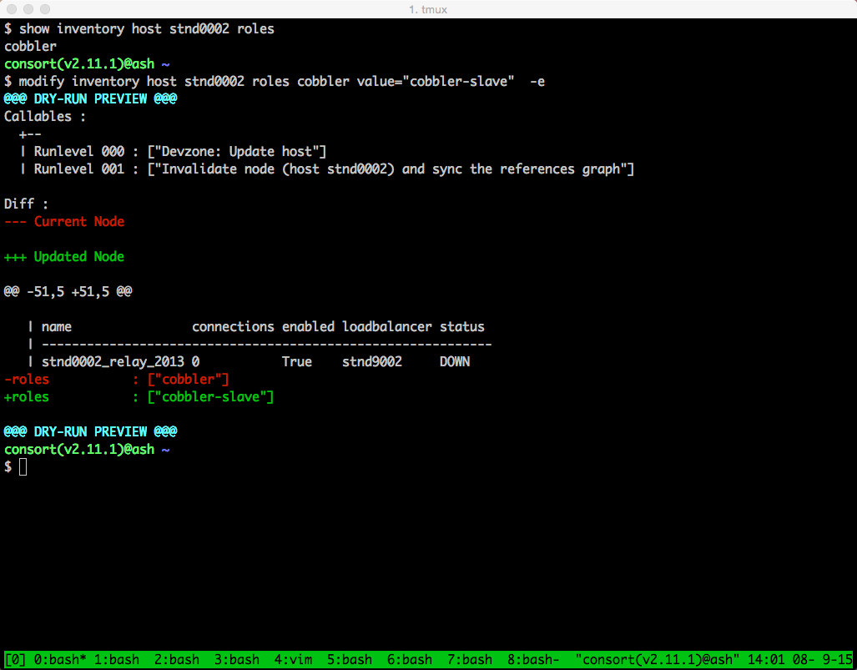

Slide 48
The future
We are planning to opensource consortium and consort with a example plugin
Watch us at https://github.com/Demonware

Slide 49
Questions?

