Slide 1
TheConsortium
Demonware data centre management and configuration tool
woosley.xu@demonware.net

Slide 2
About DemonWare
Full subsidiary of Activision Blizzard
Creates and provides the online services behind some of the world’s most popular video game franchises.

Slide 5
In China, we do … …

Slide 7
Demonware Tech

Slide 8
The unpleasant background
Working with traditional datacenter
Dealing with a lot of different backends
Everybody has their own way to do automation
Nobody knows what are the correct choices

Slide 9
so we want to pave a vm
Input hosts information manually into CMDB
use virt-manage to create virtual machines
use cobbler and input the system information
Then use virt-manager to boot it up

Slide 10
Those(and more) were killing everyone in liveops team
Everybody has their own script to automate
Provision should be simple as one command

Slide 11
The Goal of Consortium
Provide a central API for liveops operations

Slide 12
Core concepts
Everything is a kind of node, like host, vip, vlan, subnet etc.
Each kind of node has a set of attributes. For host, it has hostname, subcluster, datacenter, puppet_roles, hwspec, interfaces etc
Modify node attributes can trigger a set of operations

Slide 13
API design
Access node object through its name
Get a host GET /api/inventory/host/${HOSTNAME}
Modify host PATCH /api/inventory/host/{$HOSTNANE}
Pre compiled schema based API which can be easily used for client
#TODO insert pic here

Slide 14
Consortium V1
Tornado + Redis
Redis is used to cache node information from CMDB by a cronjob for fast query
Tornado is used to nonblockingly talk with different backends

Slide 15
Consort
The shell client talk with consortium
#todo insert pic here

Slide 16
Problems
Predefined workflow
Talking to different backends synchronous, no way to track jobs
Code for different backends are integrated into the base repo directly
#TODO: Add more here

Slide 17
Consortium V2
Core + plugin based
Consortium core as a finite state machine, propose changes to different plugins
Replace redis with etcd and arangodb

Slide 18
The new plugin system
Each plugin can provide different NodeProviders, like CobblerHostNodeProvider
NodeProvider is essentially provide attributes for a node kind
Different NodeProvider can claim attributes of the same node kind
NodeProvider also claim the authority to some node attributes.
Consortium core is responsible merging those nodes
Notes:
Only one nodeprovide can be authority of a node kind

Slide 19
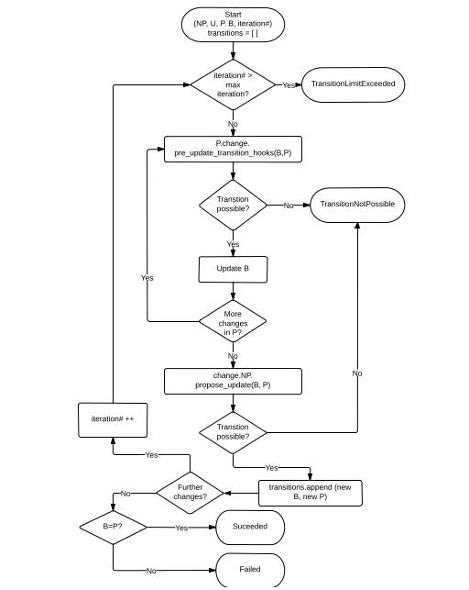
The great new transitionplanner

Slide 20
It is not that scary
User sends a set of ProposedUpdates
NodeProvider define a function accept all updates, do some operations and return what ProposedUpdates are accepted.
NodeProvider can also tell transitionPlanner to propose some new updates, which will be merged to ProposedUpdates
TransitionPlanner merge the accepted ProposedUpdates to current node, compare with desired state.
If not satisfied, continue the loop until 1)succeeded 2)failed by exceptions 3)ttl expired.

Slide 21
Show me the code
#todo insert some code here

Slide 22
Wokers in Consortium
Master worker
Web worker: main http interface
Queue worker: workers who run tasks
Notes:
Webworker: main http interface

Slide 23
Etcd and Arangodb
Etcd: LockManager, Queue
Arangodb： A great graph store just works, for jobs and inventory cache

Slide 24
Show me a work example
#todo, insert a Consort Gif here

Slide 25
The Search Engine
#Todo: show me the example

Slide 26
Other cool thing
#todo how consortium handle list attributes
Explain mode

Slide 27
The future
We are planning to opensource consortium and consort with a example plugin
Watch us at https://github.com/Demonware

Slide 28
Questions?

